Slide 1
Week 3 : Master UFO Program & Base 10 7Strong
第3周 ： 卓越超连锁店主计划及基本10顾客7人强

Slide 2
What is Master UFO Program? 什么是卓越超连锁店主计划？
Is a structured system that identifies and quantifies what successful Market America Independent UnFranchise Owners (UFOs) are doing or have done to be successful with the business plan.
这是一个很有规律的系统，它会帮助美安的超连锁店主们辨认出一位出色成功的店主该具备的条件。
This is a follow through of Basic 5 #3 Retailing & #4 Prospecting , Recruiting and Sponsoring.
这个计划的重点在于《成功五要诀》的 #3零售 #4 物色人选、超募及推荐新超连锁店主
Focus on Result Producing Activities (RPA) 可产生效益的活动
This program allows UFOs to enter into action with BELIEF and CONFIDENCE
这个计划可以让超连锁店主建立他们对这个事业的信念与信心

Slide 3
In the UnFranchise Business, you can be :- 在超连锁事业里，你可以成为以下的三大类别：-
★ Sales representative
零售商
★ UnFranchiseTM Owner (UFO)
超连锁店主
★ Master UnFranchiseTM Owner
卓越超连锁店主

Slide 4
What is a Master UFO? 什么是卓越超连锁店主计划？
A Master UnFranchise Owner is a qualified and active Independent UnFranchise Owner (UFO) who has made the commitment to master the UnFranchise Business Development System by implementing the established tasks, activities, and practices as set forth and defined in the Master UFO Program
卓越超连锁店主计划是一个合格,活跃的超连锁店主，在一个很有规律的系统下，实行每日该做的任务、活动，这个计划会帮助超连锁店主们成为一位出色成功的店主，并建立永续收入。

Slide 5
Master UFO Program
卓越超连锁计划
Success Path
成功之道

Slide 6
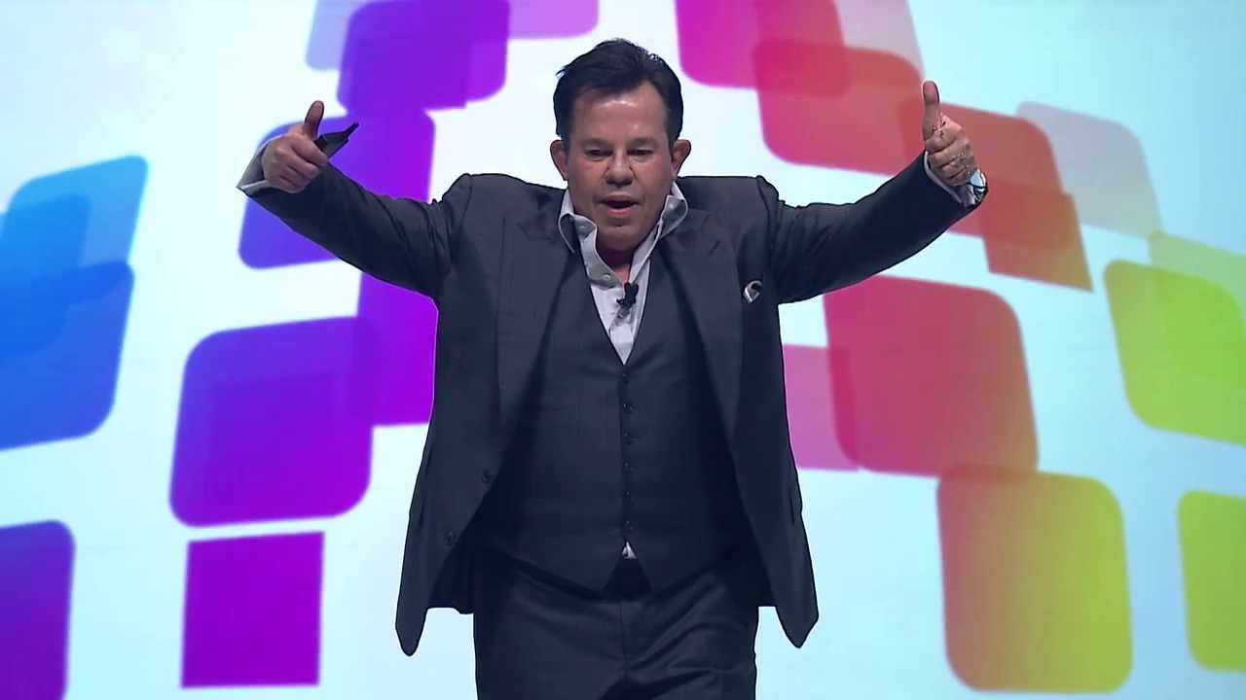
What is market America Culture?
《美安》的文化是什么？

Slide 7
The Essence of the UFO Program 卓越超连锁店主的本质
“Everyone is looking for the keys to success. When I was a Distributor, I didn't care what it took or how hard I had to work. I just wanted to know exactly what I had to do to be successful. I didn't want to learn by trial and error or work hard and not make it. I wanted to know if I did certain things, I would make it.
The UFO program clearly defines what you must do to become an accomplished UnFranchise Owner — a true professional.”
“每个人都在找一把成功的钥匙。当我还是一位新店主时，我不管我到底需要用多少的努力活其它的方法，我只想知道怎样去做，我才能成功！我不想浪费时间很努力的做，最终才发现是做错了，因为机会只有一次；所以，我希望我可以跟着一个对的系统，重复的做就能成功，这是我想要的结果。”
这一个专业的计划就是细说着一位成功超连锁店主该实行的步伐，跟着走的话，就一定会成功。
JR Ridinger President and CEO
JR 莱丁格
公司创办人及执行总裁

Slide 8
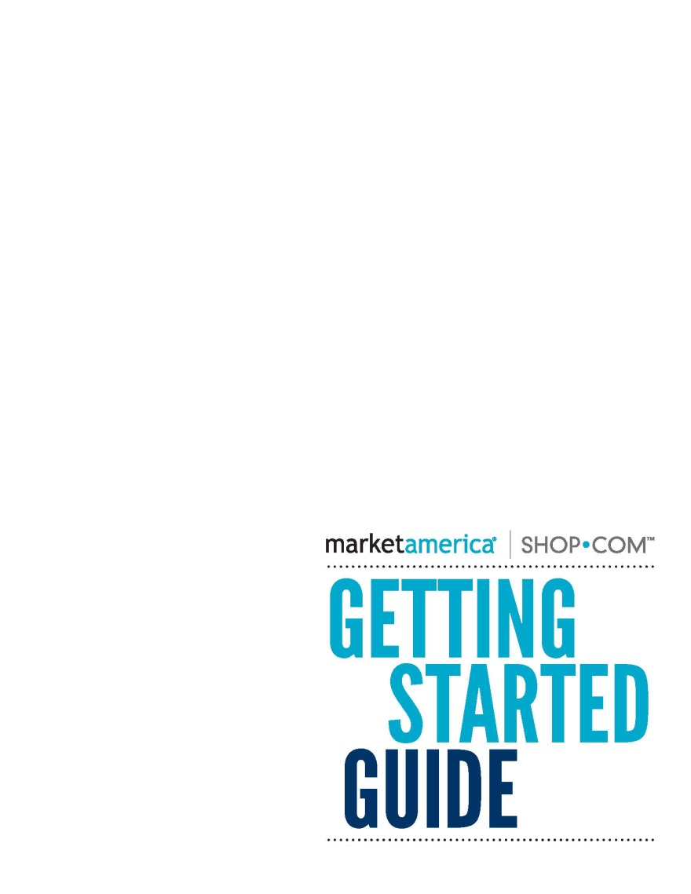
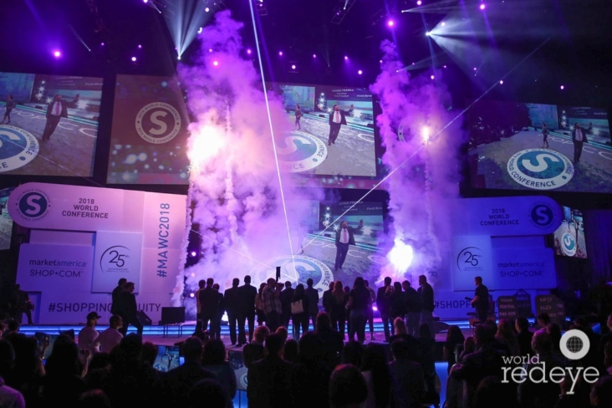
3 mths SYSTEM 三个月的系统
World Conference
世界大会
& International Convention、
国际年会
6 mths SYSTEM
六个月的系统
Master UFO
卓越超连锁店主
Lets Get Started Right
让我们开始吧
SAMM
购物年金卓越成员

Slide 9
Where to locate it: unFranchise.com 那里可以找到卓越超连锁店主计划？

Slide 10
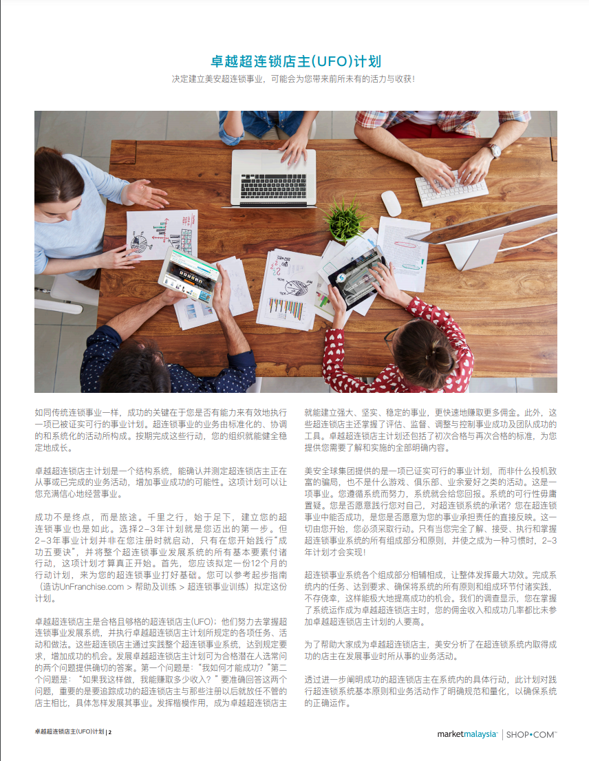

Slide 11
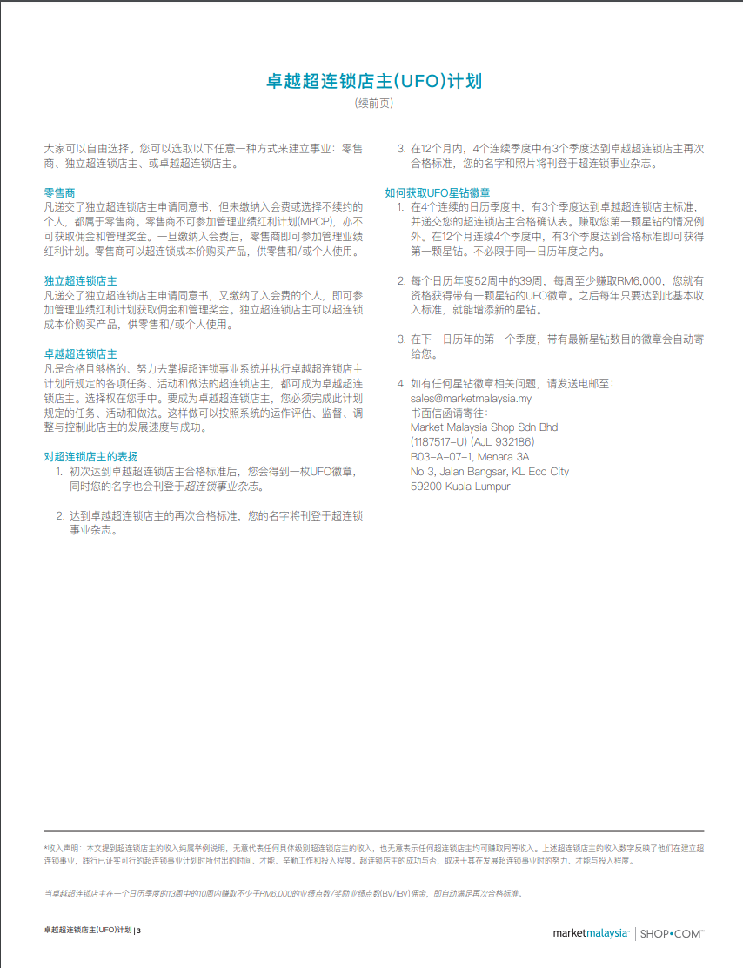
Criteria 标准

Slide 13
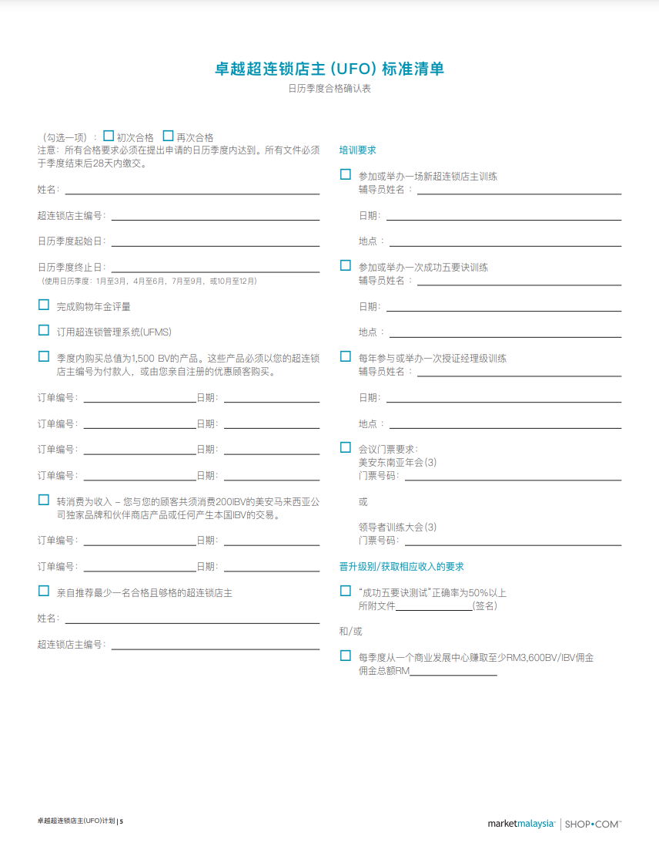

Slide 14
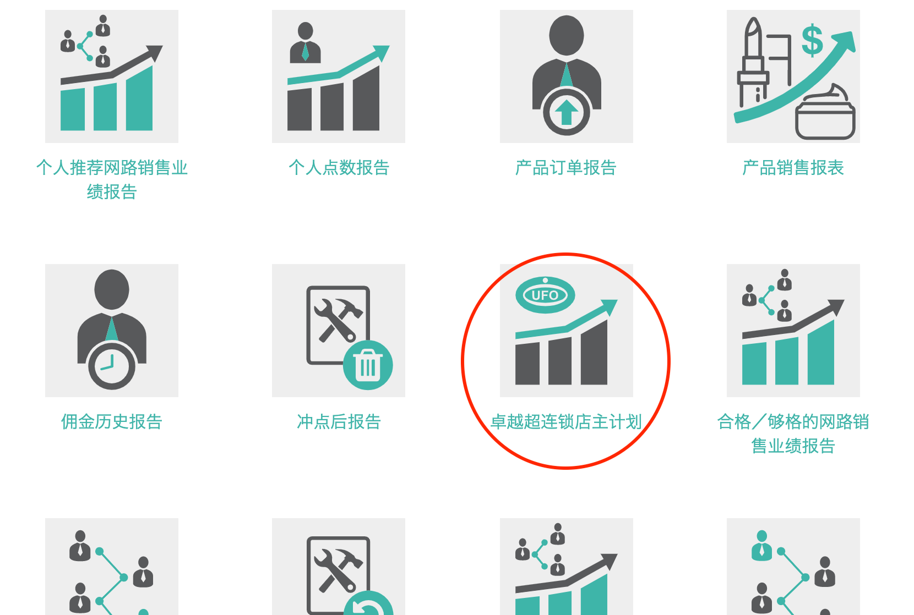
Where to locate it: unFranchise.com 那里可以找到卓越超连锁店主计划？

Slide 15
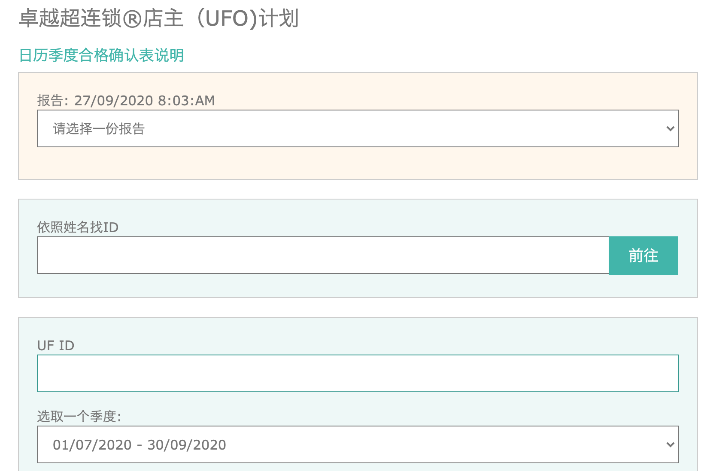
Where to monitor Progress? 在那里可以监控这个进展

Slide 16
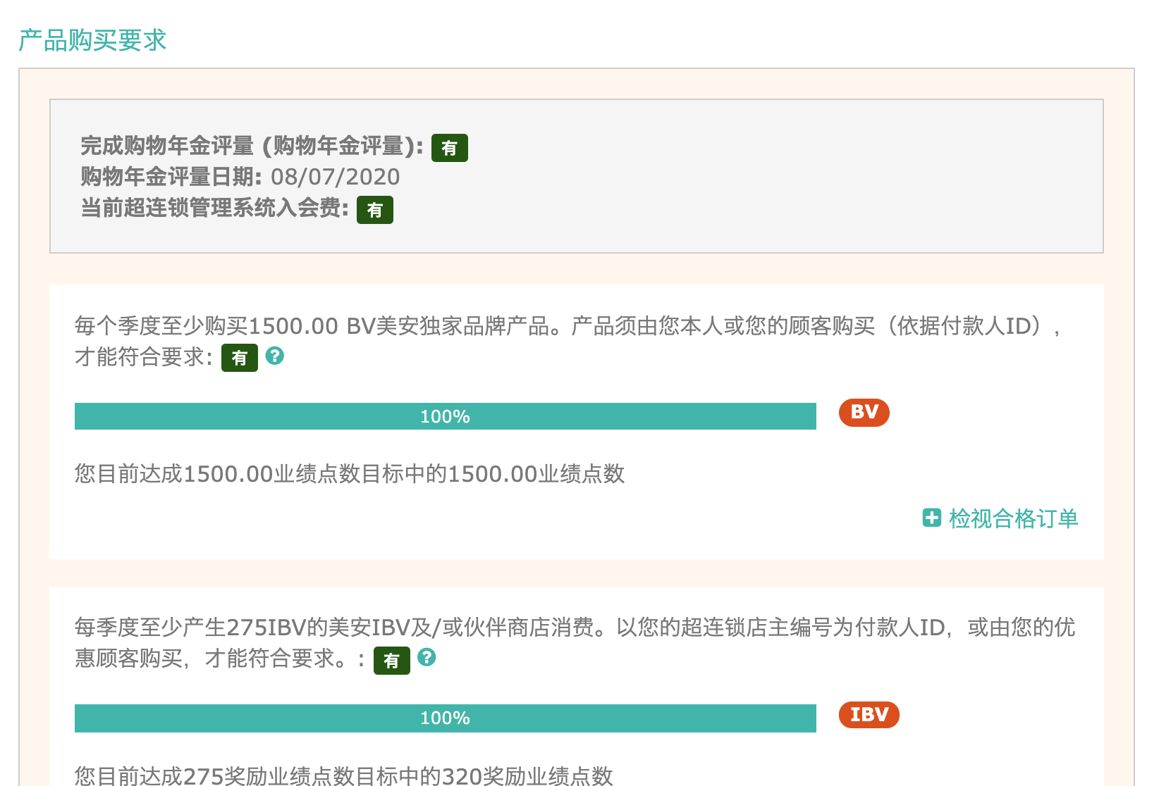

Slide 17
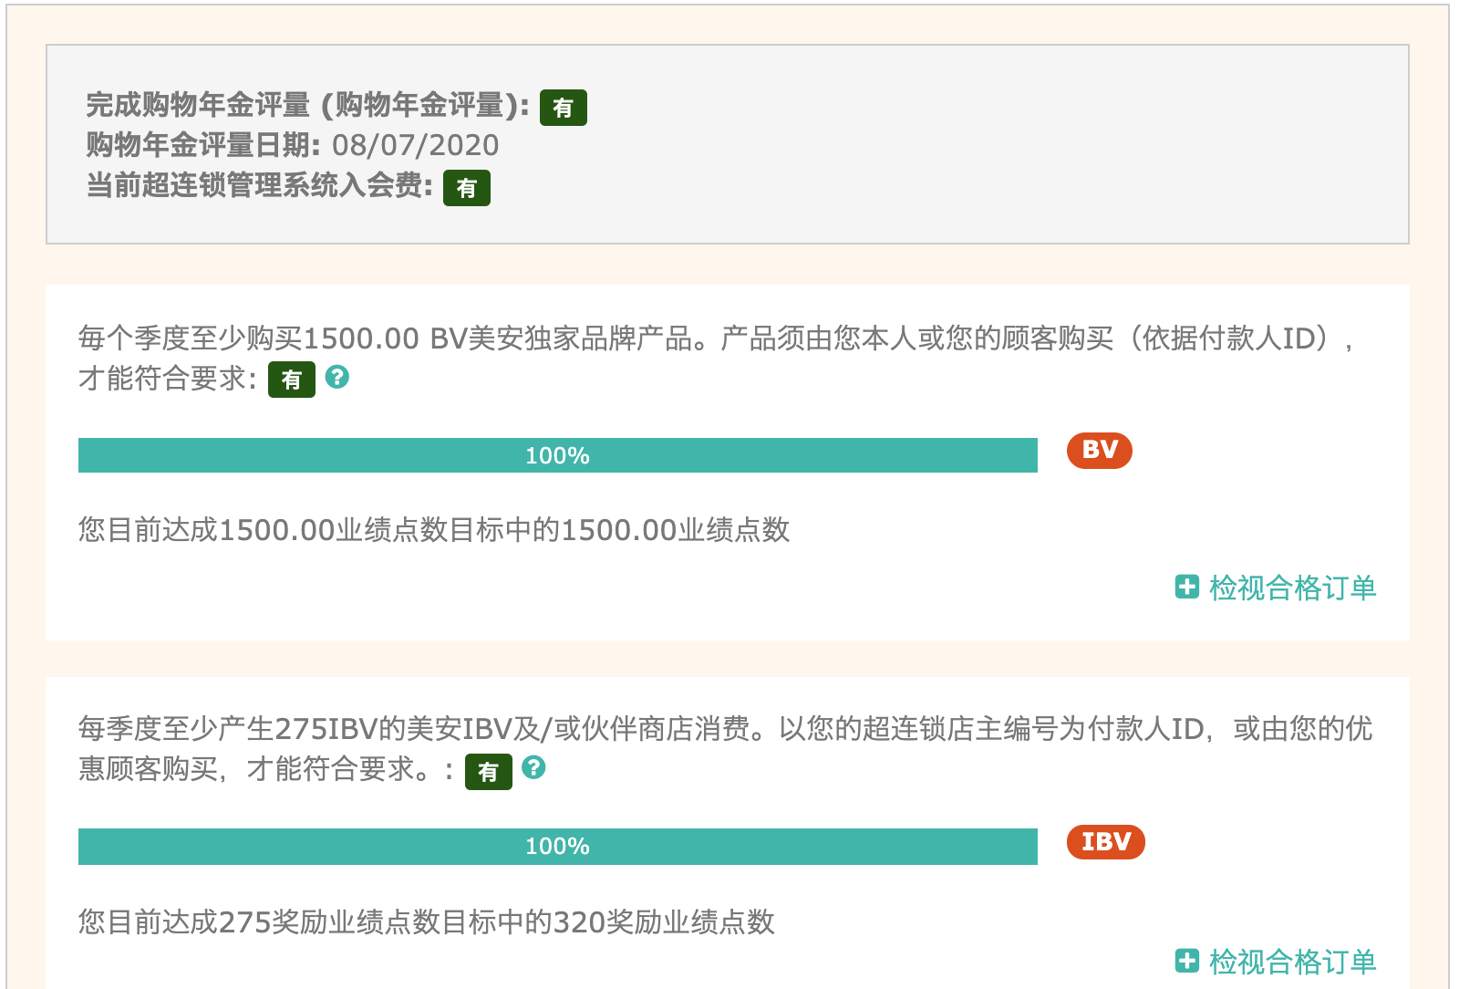

Slide 18
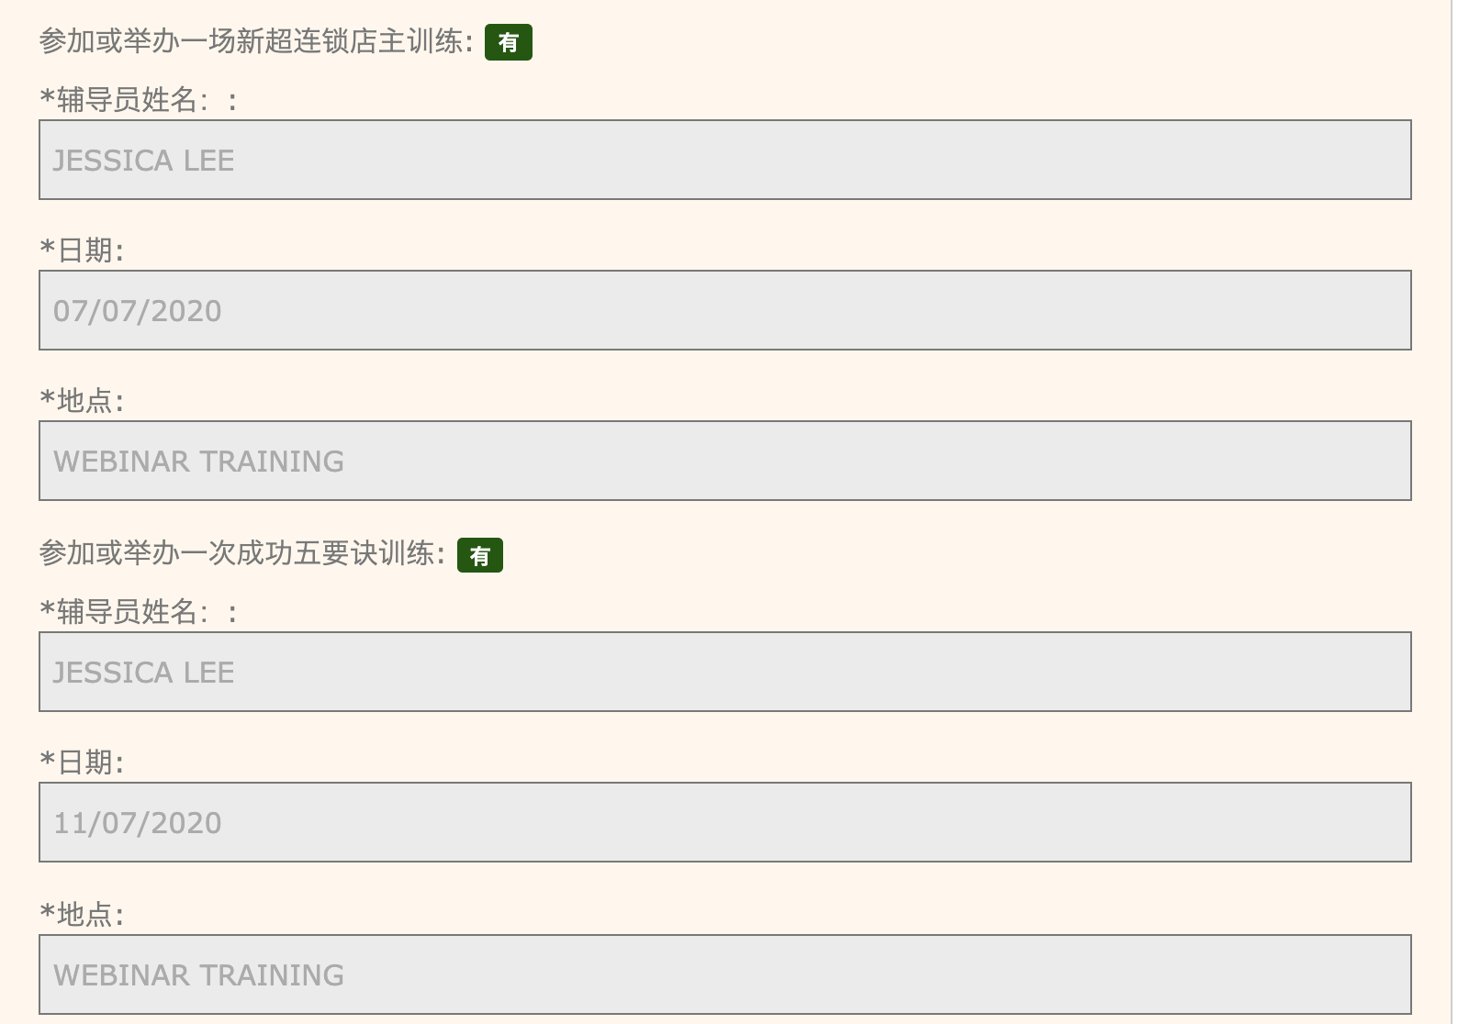

Slide 19
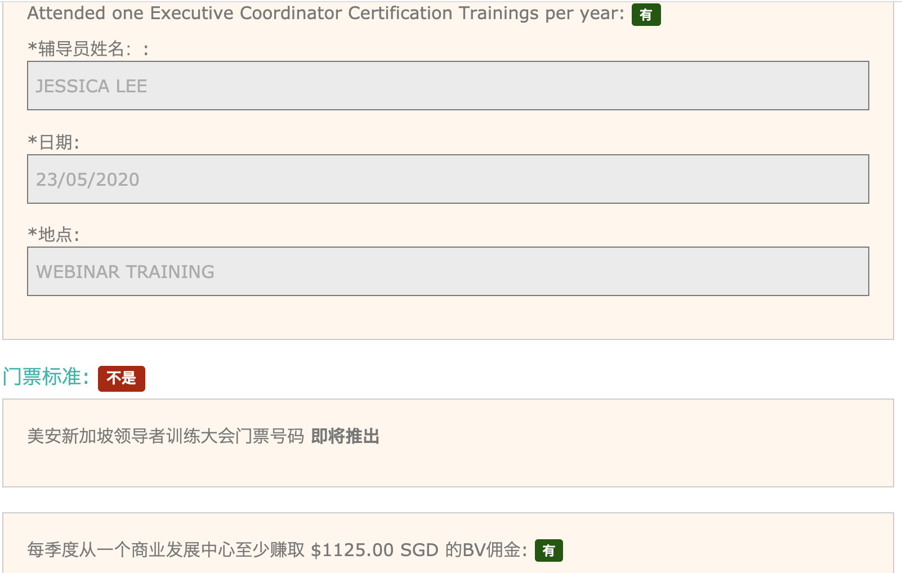

Slide 20
Key of Master UFO 卓越超连锁店主的主要关键
1500 BV = 500 BV per mth
1500 点数 = 平均每个月500点数
Sponsoring of one UFO per quarter
每一个季度招募一位新店主

Slide 21
Quarter | Personal Sponsor | Team Sponsor | Total UFO | Total BV per mth | Commission Check / mth
1-2 qtrs | 1 |  | 1 | 500BV
3-4 qtrs End of 1st year | 1 | 2 | 4 | 2000BV | USD300
5-6 qtrs | 1 | 8 | 13 | 6500BV | USD1500
7-8 qtrs End of 2nd Year | 1 | 26 | 40 | 20,000BV | USD6000
9-10 qtrs. 2 ½ years | 1 | 80 | 121 | 60,500 (15,125BV / wk) | USD8400 for life

Slide 22
Master UFO Recognition 卓越超连锁店主徽章
How to earn UFO Jacket Pin with Stone(s) 怎样可以领到卓越超连锁店主的徽章
Qualify as a Master UFO by submitting your UFO Criteria Forms three out of four consecutive calendar quarter
在后台呈交卓越超连锁店主的报告。若在四个连续日历中的三个季度达成，您将会领取第一枚砖石（注：第一枚不需要遵循日历，接下来的都必须遵循日历）
**The exception is earning your very first stone. This can be done by qualifying three out of four consecutive quarters within a 12-month period. It does not have to be within the same calendar year.**
Upon earning a minimum of USD1500 per week 39 out of 52 weeks each calendar year (9.75months) you will be eligible to receive a Pin with one stone. Additional stones will be awarded on a yearly basis provided this minimum earnings criteria is met each year.
若您在52 周之中的39周佣金，每周固定是美元1,500 、新币1,875 、 马币6,000，那你将可以每年的第一季得到公司汇给你的新徽章与新砖石
Your updated jacket pin will be sent to you automatically with the correct number of stones during the first quarter of the following calendar year.

Slide 23
Why Base 10 7 Strong? 为什么要有十个客户7、七人强

Slide 24
零售目标 Retail Sales Goal
新超连锁™店主的每月目标是本人购买并使用200 BV 和 20 IBV的产品
开发至少十位优惠顾客， 并且鼓励每人每月至少购买 30 BV / 20 IBV 的产品，
从中产生300 BV 和200 IBV
Monthly Goal for new UnFranchise® Owner is to generate 200 BV and 20 IBV from personal use
300 BV and 200 IBV to a base of at least 10 Preferred Customers ordering 30 BV and 20 IBV per month.
优惠顾客
优惠顾客
-
-
-
-
-
-
-
-
-
-
优惠顾客
优惠顾客
优惠顾客
优惠顾客
优惠顾客
优惠顾客
优惠顾客
优惠顾客
优惠顾客 = 30 BV及20 IBV
PC = 30 BV and 20 IBV
超连锁™店主每月总共产生： 500 BV及220 IBV
Total UnFranchise Owner Production: 500 BV and 220 IBV

Slide 25
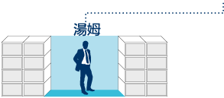
零售目标 - 基本十顾客，七人强
Retail Sales Goal - Base 10, Seven Strong
7位超连锁™店主，每人有10位优惠顾客
每位超连锁™店主每月可产生500 BV及200 IBV（个人购买及优惠顾客购买）
佣金 = 每月由BV赚取RM1,200及每两个月由IBV赚取RM1,200
1500 BV & 600 IBV
1500 BV & 600 IBV
5位优惠顾客
5位优惠顾客
500 BV & 200 IBV 点数可被放置
5位优惠顾客
5位优惠顾客
5位优惠顾客
5位优惠顾客
500 BV & 200 IBV
500 BV & 200 IBV
5位优惠顾客
5位优惠顾客
5位优惠顾客
5位优惠顾客
5位优惠顾客
5位优惠顾客
5位优惠顾客
5位优惠顾客
500 BV & 200 IBV
500 BV & 200 IBV
500 BV & 200 IBV
500 BV & 200 IBV
此投影片上BV及IBV库显示周期业绩累积

Slide 26
组织达到基本业务要求
organization Satisfying the Minimum Activity Requirements
佣金 = 每个月RM2,400 (BV)及每三个月RM1,200 (IBV)
基本业务要求
每位超连锁™店主每月50 BV + 10 IBV
总额 = 每位超连锁™店主50 BV + 10 IBV
每两个周期您可由BV赚取RM1,200 - RM2,400及每三个月由IBV赚取RM1,200
50 UFO’s x 50 BV = 每月2,500 BV
加上
50 UFO’s x 10 IBV = 每月500 IBV
50 UFO’s x 50 BV = 每月2,500 BV
加上
50 UFO’s x 10 IBV
= 每月500 IBV
此投影片上BV及IBV库显示周期业绩累积

Slide 27
组织完成每月目标及基本10顾客
organization Satisfying the Monthly Goal and base 10
佣金 = 每月RM24,000 (BV)及每月RM12,000 (IBV)
每月目标 每位超连锁™店主每月200 BV + 20 IBV
基本10顾客 每位超连锁™店主的10位优惠顾客产生
300 BV + 200 IBV
总额 = 每位超连锁™店主500 BV + 220 IBV
每个周期您可由BV赚取RM6,000及每两个周期由IBV赚取RM6,000
50 UFO’s x 500 BV = 每月25,000 BV
50 UFO’s x 200 IBV = 每月10,000 IBV
50 UFO’s x 500 BV = 每月25,000 BV
50 UFO’s x 200 IBV = 每月10,000 IBV
加上
加上
此投影片上BV及IBV库显示周期业绩累积

Slide 28
Just DO IT！ 做就对了！

